Slide 1
Lower Bounds on Assumptions behind Indistinguishability Obfuscation
Mohammad Mahmoody (University of Virginia)
Ameer Mohammed (University of Virginia)
Soheil Nematihaji (University of Virginia)
abhi shelat (University of Virginia)
Rafael Pass (Cornell University)

Slide 2


VBB Obfuscation
[Hada00, BGIRSVY01] Ideal: VBB obfuscation.
VBB Obfuscation
$$M$$
$$M′$$
[BGIRSVY01] VBB not possible in general
[CPK15,MMN15,Ps15] Not even in some idealized models

Slide 3


Next best thing?
Indistinguishability Obfuscation
$$M$$
$$M′$$
[GGHRSW13] Candidate iO

Slide 4
Applications and Related Results of iO
Functional Encryption: [Garg-Gentry-Halevi-Raykova-Sahai-Waters 2013]
Witness Encryption: [Garg-Gentry-Sahai-Waters 2013]
2-round MPC: [Garg-Gentry-Halevi-Raykova 2013]
Re-using garbled circuits: [Gentry–Halevi–Raykova-Wichs 2014]
Deniable Encryption, KEM, Oblivious Transfer,…: [Sahai-Waters 2014]
Random oracle instantiation: [Hohenberger-Sahai-Waters 2014]
Secret sharing: [Komargodski-Naor 2014]
2-round adaptively-secure MPC: [Garg-Polychroniadou 2015]
Multi-input Functional Encryption: [Goldwasser-Gordon-Goyal-Jain-Katz-Liu-Sahai-Shi-Zhao 2015]
………..
…
Indistinguishability Obfuscation

Slide 5

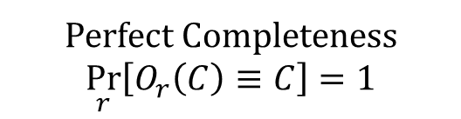
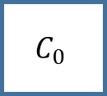
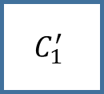







Indistinguishability Obfuscation (iO)
$$C_{0}$$
$$C_{1}$$
$$≡$$
Obfuscator
Obfuscator
$$C_{0}$$
$$C_{0}^{′}$$
$$C_{1}^{′}$$
$$C_{1}$$
$$≡$$
$$≈_{c}$$
$$≡$$
A
Perfect Completeness
$$\underset{r}{Pr}\left[O_{r}\left(C\right)≡C\right]=1$$

Slide 6
Landscape
Indistinguishability Obfuscation
(iO)
[GGH+13]
Functional Encryption
PKE
Oblivious Transfer
KEM
…
…
(Idealized) Graded Encoding Schemes
[SW14]
[BR14, BGK+14,PST14, GLSW14]
Black-box
CRHF
FHE
Multilinear Maps (+LWE)
[AS15]
[GGH+13]
Notes:
Attacks on MLM

Slide 7
What assumptions give us iO?
Can we use “standard assumptions”?

Slide 8
Landscape and Goals
OWF
CRHF
TDP…
Indistinguishability Obfuscation
(iO)
[GGH+13]
Functional Encryption
???
PKE
Oblivious Transfer
KEM
…
…
(Idealized) Graded Encoding Schemes
[SW14]
[BR14, BGK+14,PST14, GLSW14]
CRHF
FHE
Multilinear Maps (+LWE)
[AS15]
[GGH+13]

Slide 9
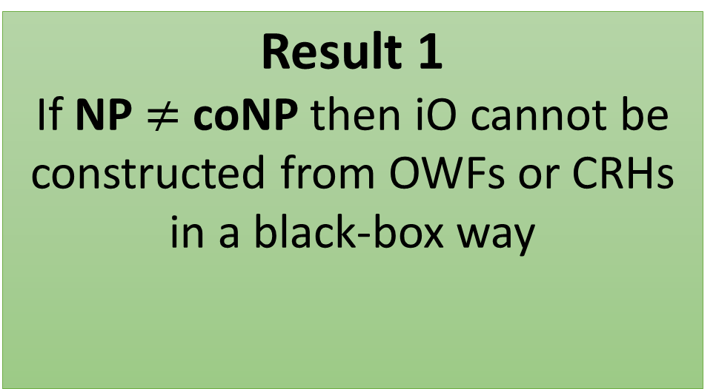
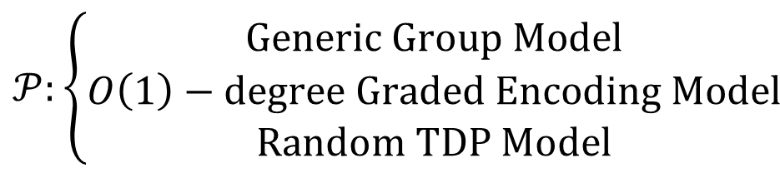
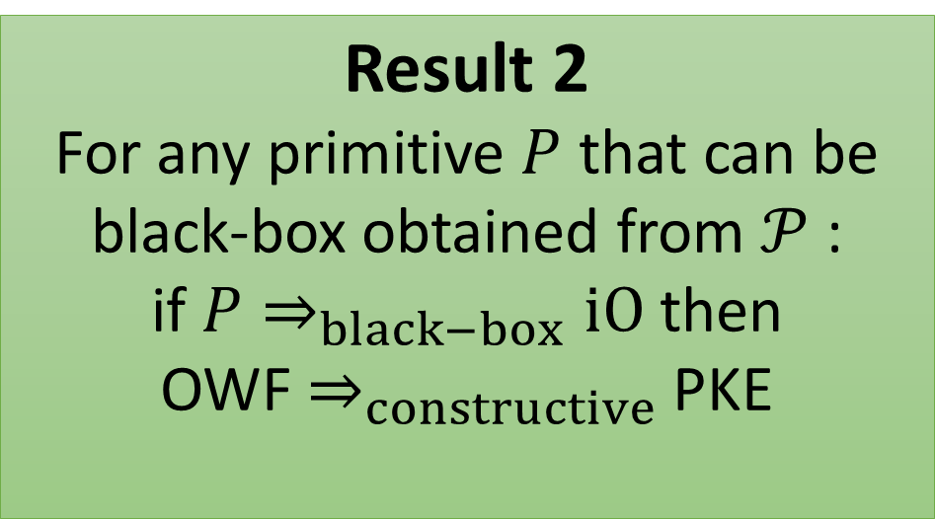
Main results in this talk
Result 1
If NP $≠$ coNP then iO cannot be constructed from OWFs or CRHs in a black-box way
Result 2
For any primitive $P$ that can be black-box obtained from $𝒫$ :
if $P⇒_{black−box}iO$ then
OWF $⇒_{constructive}$ PKE
$$𝒫:\left\{\begin{aligned}Generic Group Model \\ O\left(1\right)−degree Graded Encoding Model \\ Random TDP Model\end{aligned}\right.$$
Notes:
Result 1: NP != coNP => (OWF =/=> iO)
Result 2: (OWF =/=> PKE) => (P =/=> iO)
Computational assumption necessary for result 1
Say that they are informal statements
Talk about [AS15] negative result for pFE -> iO(C^f)
Constructive (construction/security reduction allowed to be non-black box)

Slide 10
Black-Box Separation of iO from OWF
Known constructions that use iO as a primitive yield non-black-box constructions naturally.
Still meaningful to explore whether we can get black-box constructions of iO.
Analogy: ZK Proofs for polynomial size circuits

Slide 11






Overview of Techniques
Indistinguishability Obfuscation
$${iO}^{poly−deg GEM}$$
$${iO}^{O\left(1\right)−deg GEM}$$
PKC from OWF
$${iO}^{GGM}$$
$${iO}^{RTP}$$
$${iO}^{RO}$$
$$NP=coNP$$

Slide 12
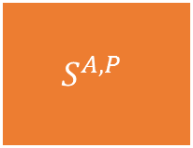


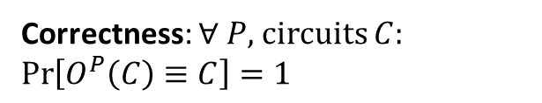
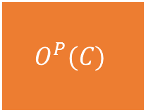




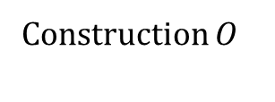
Fully Black-Box (BB) Construction of iO
[IR89, RTV04]
A fully BB construction of iO from $𝒫$ consists of two PPT oracle algorithms $(O,S)$:
Note: plain-model circuits
Primitive $𝒫$
Construction $O$
$$P$$
$$O^{P}(C)$$
Correctness: $∀ P$, circuits $C$:
$\operatorname{Pr}\left[O^{P}\left(C\right)≡C\right]=1$
Security: $∀ P,A$, if for infinite pairs of equivalent circuits $(C_{0},C_{1})$:
$$\operatorname{Pr}\left[A\left(B\right)=b;b\underset{←}{\$}\left\{0,1\right\},B←O(C_{b})\right]≥\frac{1}{2}+\frac{1}{poly(n)}$$
Then:
$S^{A,P}$ breaks the security of $P$
$$S^{A,P}$$
$$A$$
Security Reduction $S$
Adversary $A$

Slide 13
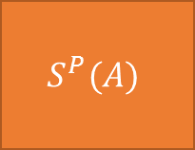
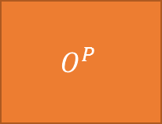


Semi-Black-Box Construction of iO (RTV04)
A semi-BB construction of iO from $𝒫$ consists of two PPT oracle algorithms $(O,S)$:
Primitive $𝒫$
Construction $O$
$$P$$
$$O^{P}$$
Correctness: $∀ P$, circuits $C$:
$\operatorname{Pr}\left[O^{P}\left(C\right)≡C\right]=1$
Security: $∀ P,A$, if for infinite pairs of equivalent circuits $(C_{0},C_{1})$:
$$\operatorname{Pr}\left[A\left(B\right)=b;b\underset{←}{\$}\left\{0,1\right\},B←O(C_{b})\right]≥\frac{1}{2}+\frac{1}{poly(n)}$$
Then:
$S^{A,P}$ breaks the security of $P$
$$S^{P}(A)$$
$$A$$
Security Reduction $S$
Efficient Adversary $A$

Slide 14
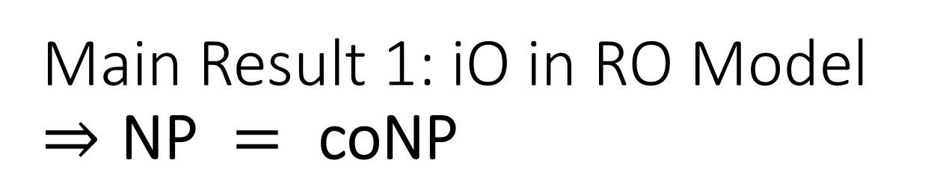
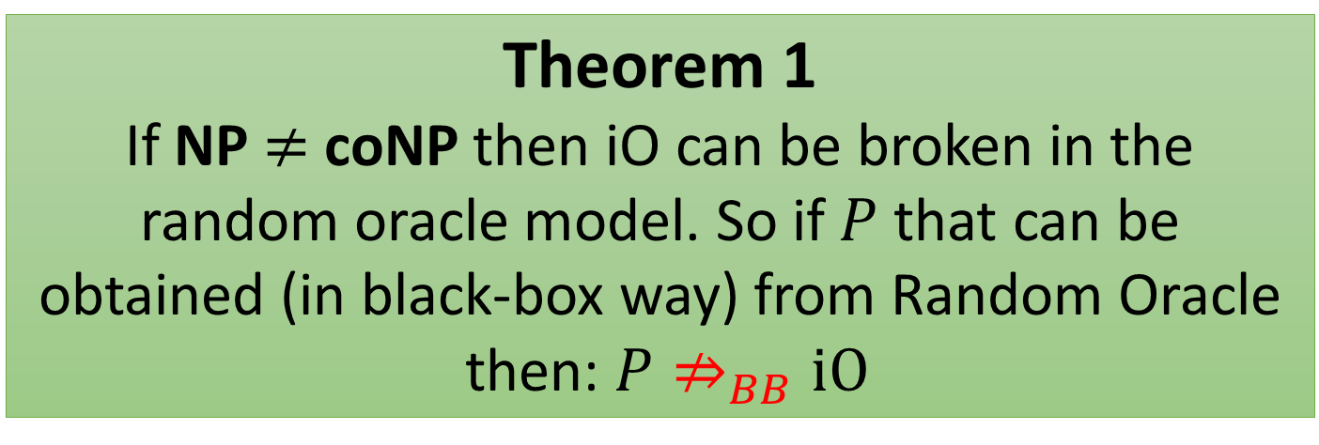
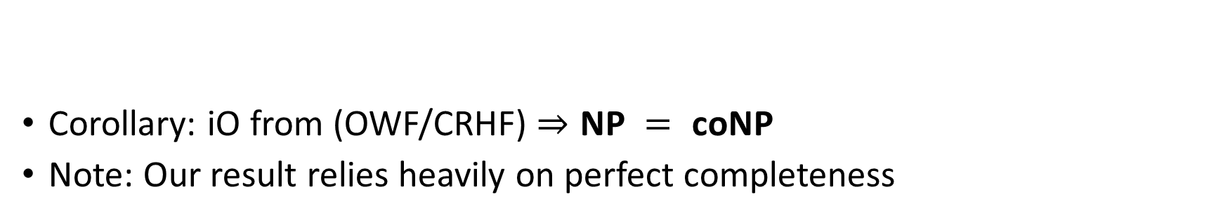
Main Result 1: iO in RO Model $⇒\text{NP} = \text{coNP}$
Theorem 1
If NP $≠$ coNP then iO can be broken in the random oracle model. So if $P$ that can be obtained (in black-box way) from Random Oracle
then: $P⇏_{BB}iO$
Corollary: iO from (OWF/CRHF) $⇒\text{NP} = \text{coNP}$
Note: Our result relies heavily on perfect completeness
Notes:
OWP (for large enough n?)

Slide 15
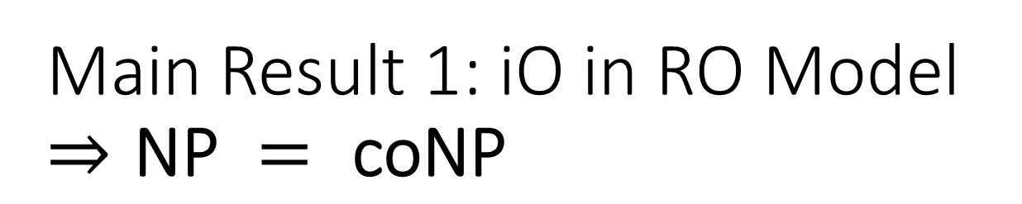
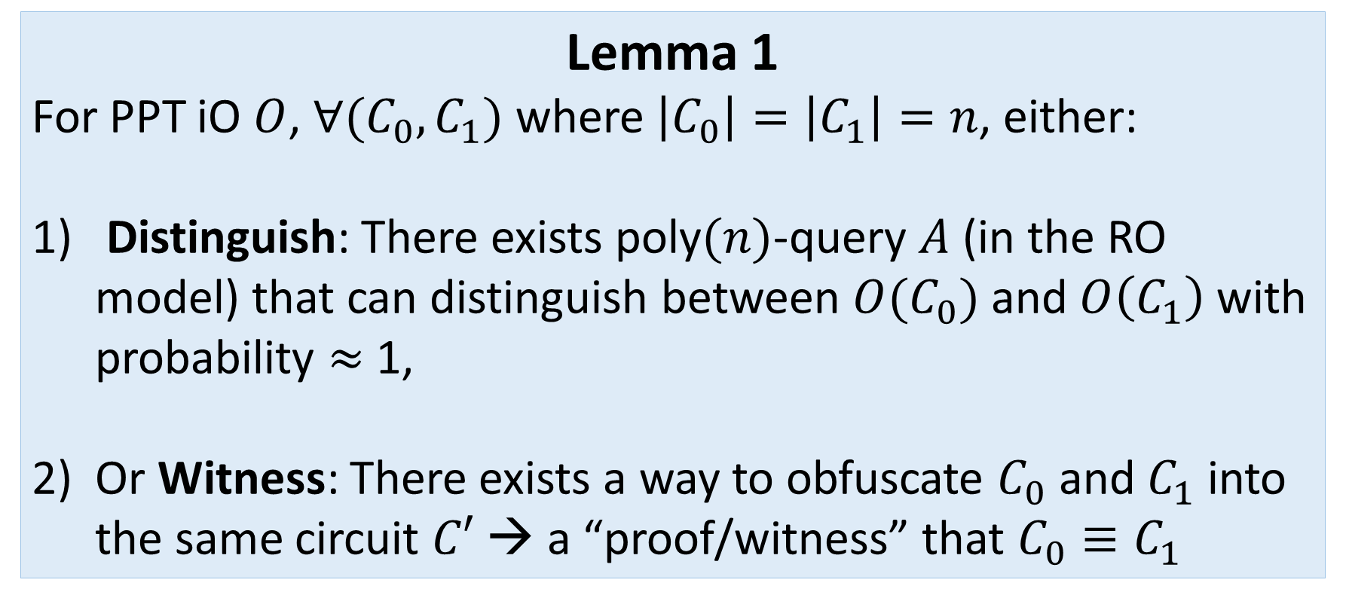
Main Result 1: iO in RO Model $⇒\text{NP} = \text{coNP}$
Lemma 1
For PPT iO $O$, $∀(C_{0},C_{1})$ where $\left|C_{0}\right|=\left|C_{1}\right|=n$, either:
Distinguish: There exists poly$(n)$-query $A$ (in the RO model) that can distinguish between $O(C_{0})$ and $O\left(C_{1}\right)$ with probability $≈$ 1,
Or Witness: There exists a way to obfuscate $C_{0}$ and $C_{1}$ into the same circuit $C′$ → a “proof/witness” that $C_{0}≡C_{1}$
Notes:
Typo: you assumed equivalence.
Note that if Case 2 happens then C0 MUST be equiv to C1. If C1 \neq C0, Case 2 cannot happen by PERFECT completeness of iO
Two circuits equivalent: coNP-complete

Slide 16
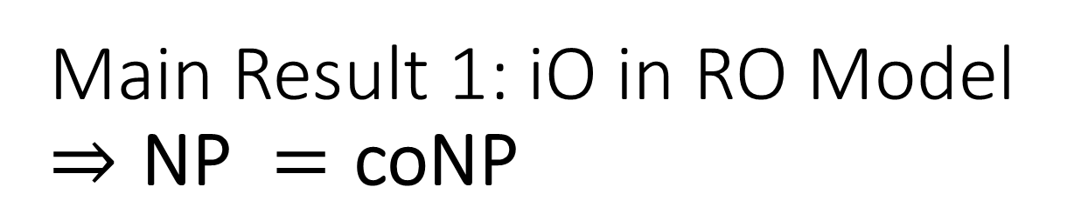
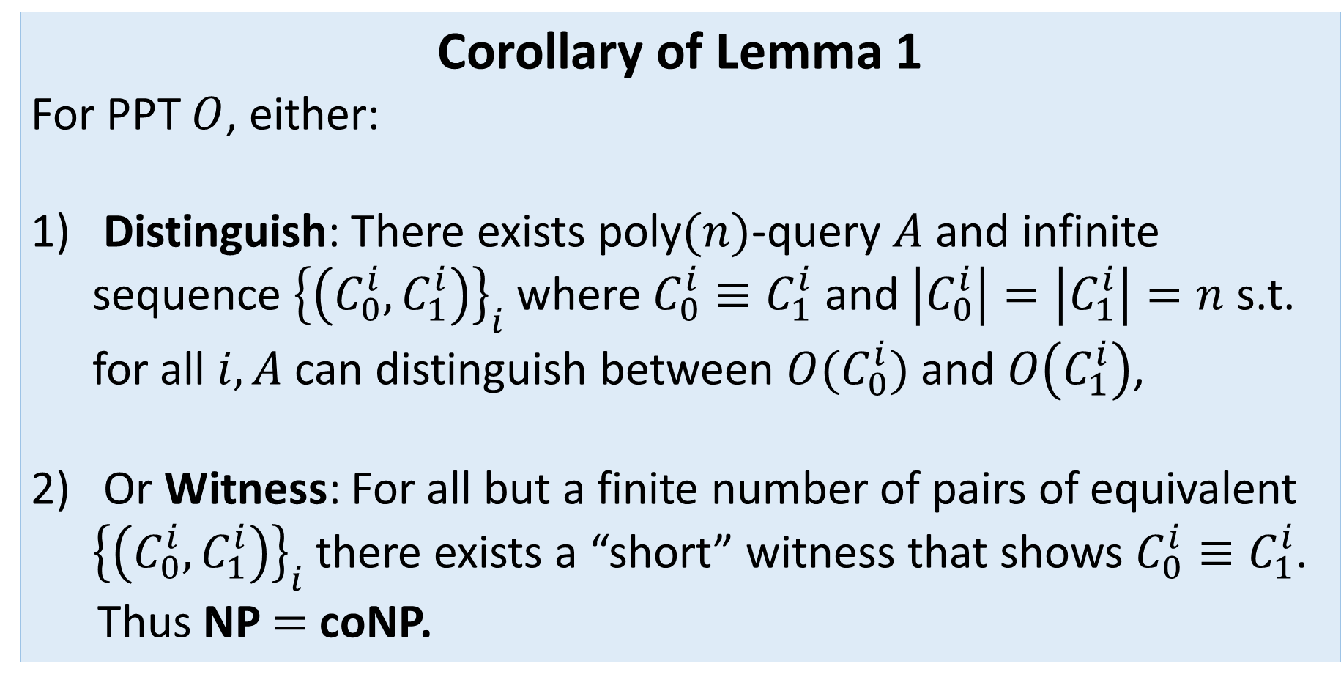
Main Result 1: iO in RO Model $⇒\text{NP} =\text{coNP}$
Corollary of Lemma 1
For PPT $O$, either:
Distinguish: There exists poly$(n)$-query $A$ and infinite sequence ${\left\{\left(C_{0}^{i},C_{1}^{i}\right)\right\}}_{i}$ where $C_{0}^{i}≡C_{1}^{i}$ and $\left|C_{0}^{i}\right|=\left|C_{1}^{i}\right|=n$ s.t. for all $i,A$ can distinguish between $O(C_{0}^{i})$ and $O\left(C_{1}^{i}\right)$,
Or Witness: For all but a finite number of pairs of equivalent ${\left\{\left(C_{0}^{i},C_{1}^{i}\right)\right\}}_{i}$ there exists a “short” witness that shows $C_{0}^{i}≡C_{1}^{i}$.
Thus NP $=$ coNP.

Slide 17

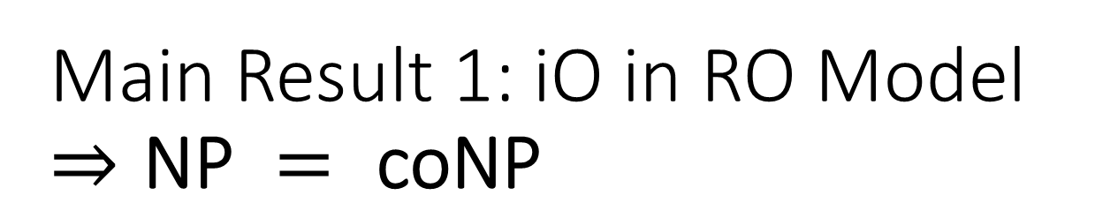






Main Result 1: iO in RO Model $⇒\text{NP} = \text{coNP}$
Proof of Lemma 1: Distinguish or Witness
Follows from [MP12]
Case 1:
$A^{P}\left(C_{0},C_{1},O_{r}^{P}\left(C_{b}\right)\right)$ learns likely queries $Q$ of $O^{P}$ and try to guess $b$
$A$ could guess $b$ with probability close to 1
$$(C_{0},C_{1})$$
$$P$$
$$(C_{0},C_{1})$$
$$O^{P}$$
$$O_{r}^{P}\left(C_{b}\right)$$
$$A^{P}$$
Notes:
NIC in ROM but will rephrase the proof to be in context of iO

Slide 18



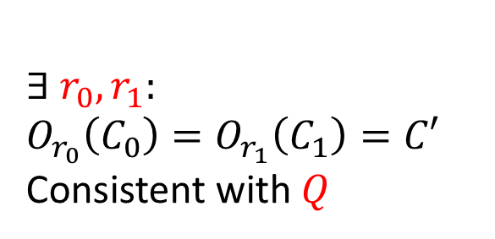

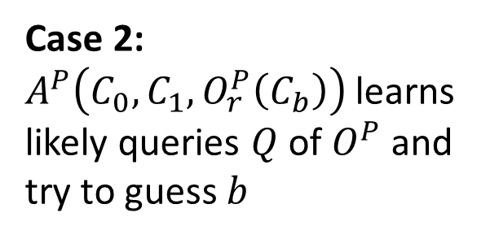


Main Result 1: iO in RO Model $⇒\text{NP} = \text{coNP}$
Proof of Lemma 1: Distinguish or Witness
Follows from [MP12]
Case 2:
$A^{P}\left(C_{0},C_{1},O_{r}^{P}\left(C_{b}\right)\right)$ learns likely queries $Q$ of $O^{P}$ and try to guess $b$
$$(C_{0},C_{1})$$
$$P$$
$$(C_{0},C_{1})$$
$$∃ r_{0},r_{1}:$$
$$O_{r_{0}}\left(C_{0}\right)=O_{r_{1}}\left(C_{1}\right)=C′$$
Consistent with $Q$
$$O^{P}$$
$$O_{r}^{P}\left(C_{b}\right)=C′$$
$$A^{P}$$
By perfect completeness
Notes:
NIC in ROM but will rephrase the proof to be in context of iO

Slide 19
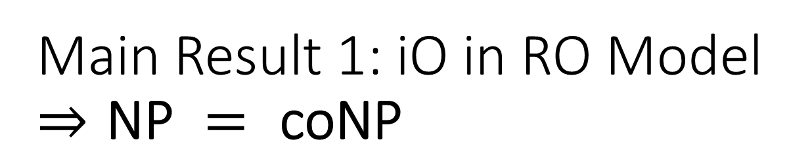
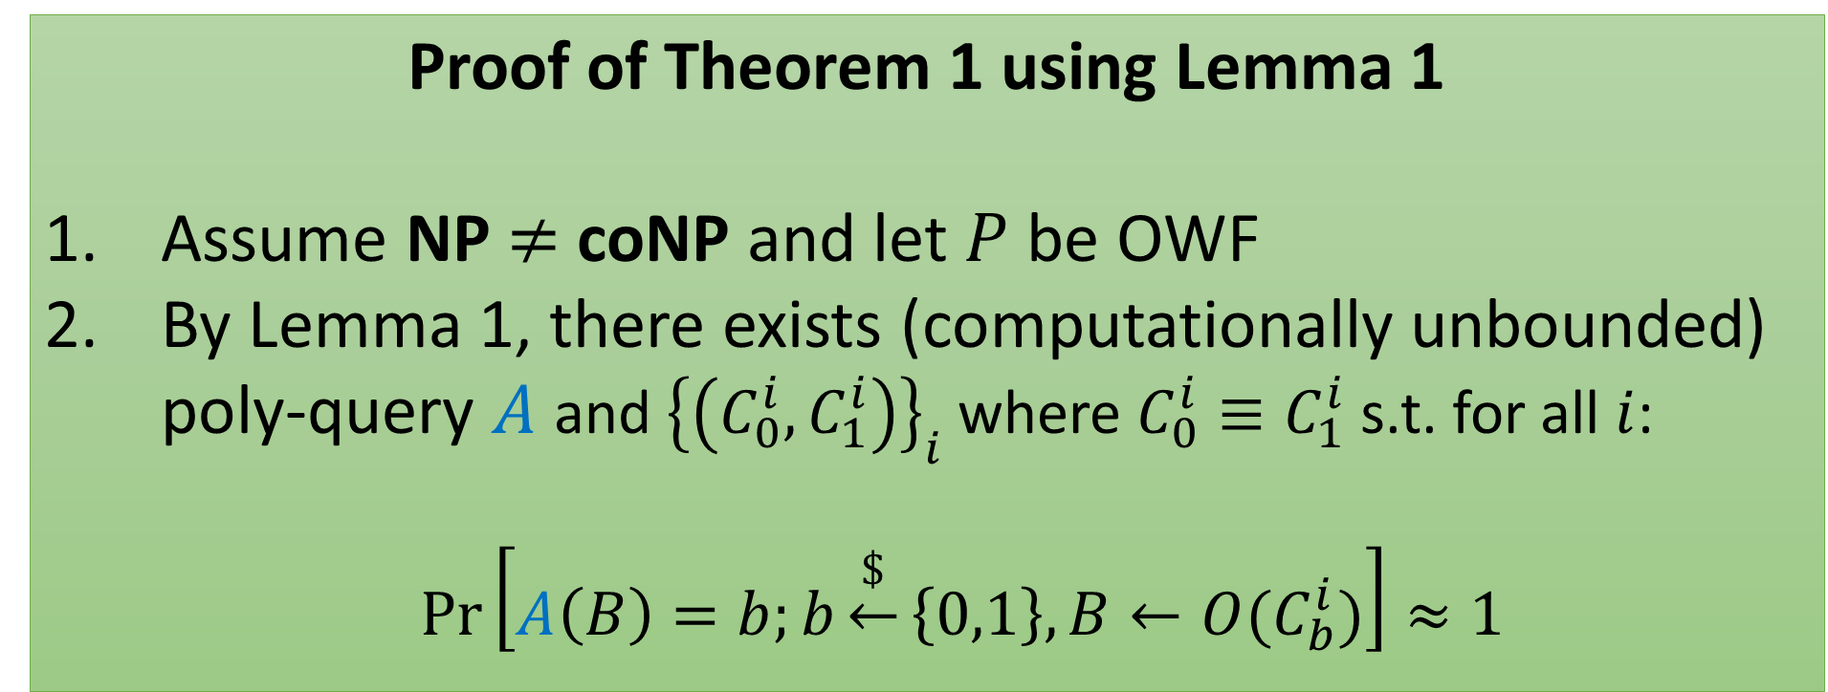
Main Result 1: iO in RO Model $⇒\text{NP} = \text{coNP}$
Proof of Theorem 1 using Lemma 1
Assume NP $≠$ coNP and let $P$ be OWF
By Lemma 1, there exists (computationally unbounded) poly-query $A$ and ${\left\{\left(C_{0}^{i},C_{1}^{i}\right)\right\}}_{i}$ where $C_{0}^{i}≡C_{1}^{i}$ s.t. for all $i$:
  $\operatorname{Pr}\left[A\left(B\right)=b;b\underset{←}{\$}\left\{0,1\right\},B←{O(C}_{b}^{i})\right]≈1$

Slide 20

Main Result 1: iO in RO Model $⇒\text{NP} = \text{coNP}$
(Contd.) Proof of Theorem 1 using Lemma 1
By definition of fully BB, security reduction + poly-query attacker, together break one-wayness of random function (which is trivially impossible).

Slide 21
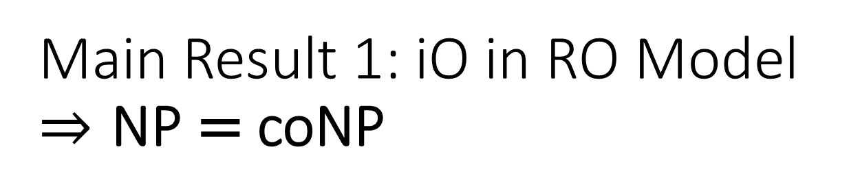



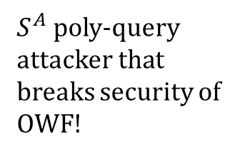



Main Result 1: iO in RO Model $⇒\text{NP} \text{= }\text{coNP}$
(Contd.) Proof of Theorem 1 using Lemma 1
OWF
$$P$$
$∴NP≠coNP⇒$ $\left(OWF⇏_{BB}iO\right)$
By definition of BB
$S^{A}$ poly-query attacker that breaks security of OWF!
$$S$$
$$A$$
Security Reduction $S$
(poly-query) Adversary $A$

Slide 22

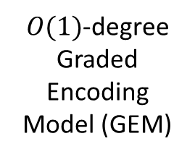
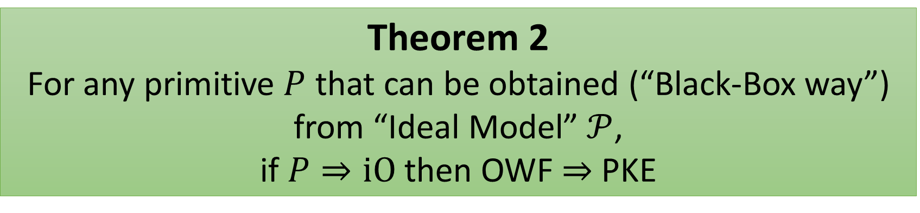
Main Result 2: iO from $𝒫 ⇒$ PKE from OWF
Random (Ideal) TDP
Model (RTP)
Generic Group Model (GGM)
$O(1)$-degree Graded Encoding Model (GEM)
Theorem 2
For any primitive $P$ that can be obtained (“Black-Box way”) from “Ideal Model” $𝒫$,
if $P⇒iO$ then OWF $⇒$ PKE
Notes:
This is not an impossibility result, and simply says that if P => iO then you might as well have found a construction of PKE from OWF (not BB so IR result does not apply here).

Slide 23

Indistinguishability Obfuscation (iO)
$$C_{0}$$
$$C_{1}$$
$$≡$$
Obfuscator
Obfuscator
$$C_{0}$$
$$C_{0}^{′}$$
$$C_{1}^{′}$$
$$C_{1}$$
$$≡$$
$$≈_{c}$$
$$≡$$
A
$$\underset{r}{Pr}\left[O_{r}\left(C\right)≡C\right]=1$$

Slide 24












Approx. Indistinguishability Obfuscation ($ε$-iO)
$$C_{0}$$
$$C_{1}$$
$$≡$$
Obfuscator
Obfuscator
$$C_{0}$$
$$C_{0}^{′}$$
$$C_{1}^{′}$$
$$C_{1}$$
$$≈_{ε}$$
$$≈_{c}$$
$$≈_{ε}$$
A
    $$\underset{r,x}{Pr}\left[O_{r}\left(C\right)\left(x\right)≠C\left(x\right)\right]≤ε(n)$$

Slide 25
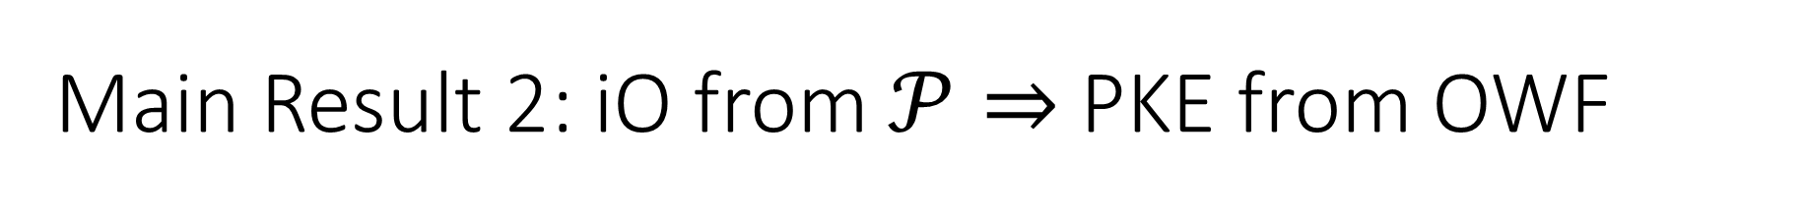
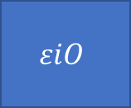

Main Result 2: iO from $𝒫⇒$ PKE from OWF
Approximately correct and approximately secure
[MMN15, Ps15]
(Previous talk)
$$iO^{𝒫}$$
$$εiO$$
[SW14, BV15]
Approx.
PKE
[DNR04, Hol06]
PKE
OWF

Slide 26















OWF + iO $→$ PKE
[SW14] PKE construction:
$$sk=k$$
Obfuscator
$$pk$$
$${Enc}_{k}\left(r,b\right)≔\left(PRG\left(r\right),PRF\left(k,PRG\left(r\right)\right)⊕b\right)$$
$$O\left({Enc}_{k}\right)$$
$$pk$$
$$b$$
$$Encrypt\left(pk,b;r\right):$$
$$O\left({Enc}_{k}\right)$$
$$c=(c_{1},c_{2})$$
$$r$$
$$c$$
$$Decrypt\left(sk,c\right):$$
$$PRF\left(k,c_{1}\right)⊕c_{2}$$
$$b$$
$$k$$

Slide 27



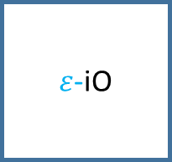


OWF + $ε$-iO $→$ PKE
Follows from [SW14] construction:
$$sk=k$$
$ε$-iO
$$pk$$
$${Enc}_{k}\left(r,b\right)≔\left(PRG\left(r\right),PRF\left(k,PRG\left(r\right)\right)⊕b\right)$$
$$O\left({Enc}_{k}\right)$$
$$pk$$
$$b$$
$$Encrypt\left(pk,b;r\right):$$
$$O\left({Enc}_{k}\right)$$
$$c=(c_{1},c_{2})$$
$$r$$
$$c$$
$$Decrypt\left(sk,c\right):$$
$$PRF\left(k,c_{1}\right)⊕c_{2}$$
$$b$$
$$k$$

Slide 28

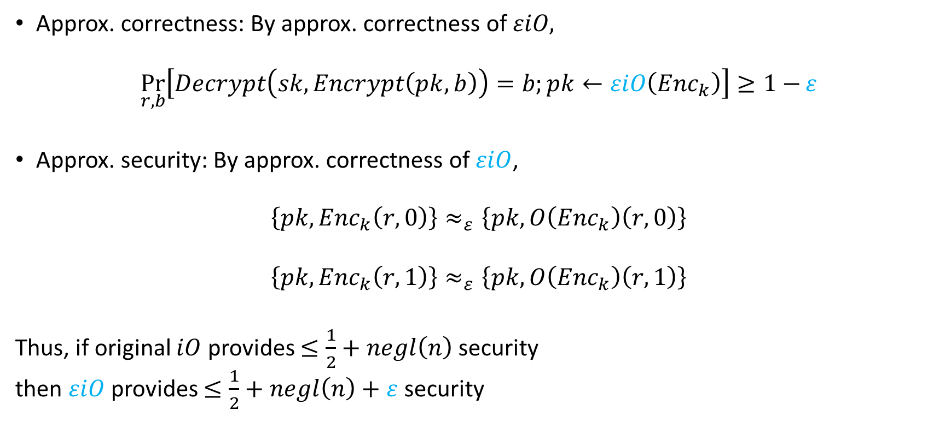
OWF + $ε$iO $→$ approx. PKE
Approx. correctness: By approx. correctness of $εiO,$
$$\underset{r,b}{Pr}\left[Decrypt\left(sk,Encrypt\left(pk,b\right)\right)=b;pk←εiO\left({Enc}_{k}\right)\right]≥1−ε$$
Approx. security: By approx. correctness of $εiO$,
$$\left\{pk,{Enc}_{k}\left(r,0\right)\right\}≈_{ε}\left\{pk,O\left({Enc}_{k}\right)\left(r,0\right)\right\}$$
$$\left\{pk,{Enc}_{k}\left(r,1\right)\right\}≈_{ε}\left\{pk,O\left({Enc}_{k}\right)\left(r,1\right)\right\}$$
Thus, if original $iO$ provides $≤\frac{1}{2}+negl\left(n\right)$ security
then $εiO$ provides $≤\frac{1}{2}+negl\left(n\right)+ε$ security

Slide 29





Relating Result 2 to [BV15]
$$PKE$$
[MMN15, Ps15]
(Previous talk)
$$iO^{𝒫}$$
$$εiO$$
$$OT$$
[BV15]
$$iO$$
$$KEM$$
DDH/sub-exp PPRF
OWF
$$FE$$

Slide 30
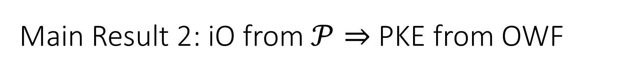
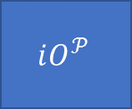
Main Result 2: iO from $𝒫⇒$ PKE from OWF
Approximately correct and approximately secure
$$iO^{𝒫}$$
[MMN15, Ps15]
$$εiO$$
[SW14, BV15]
Approx.
PKE
[DNR04, Hol06]
PKE
OWF

Slide 31
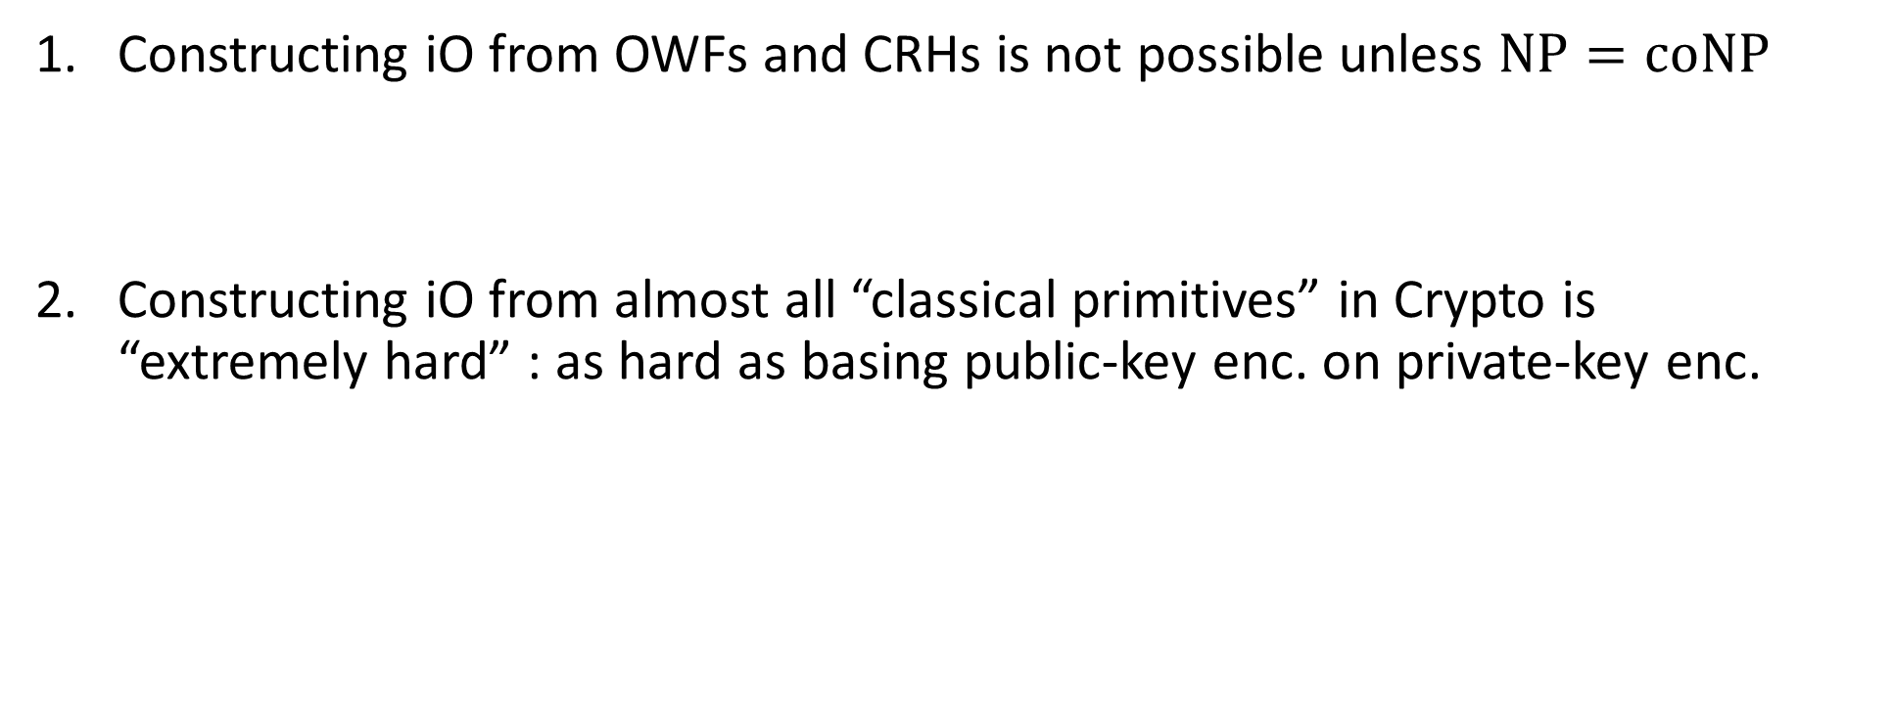
Conclusion
Constructing iO from OWFs and CRHs is not possible unless $NP=coNP$
Constructing iO from almost all “classical primitives” in Crypto is
“extremely hard” : as hard as basing public-key enc. on private-key enc.

